Slide 1

Image Processing Tool: Version 2.0
The A Team
Sanan Aamir, Romando Garcia,
Anne Lam, James Rowe, Hieu Tran
Final Presentation
May 4, 2015

Slide 2
Outline
Introduction
System Architecture
Version 1.0 and new objectives in Version 2.0
Plan
Organization
Work-to-date and Future Work

Slide 3
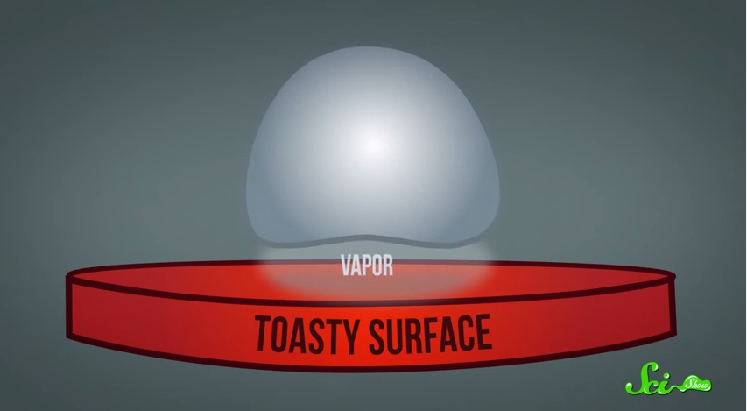
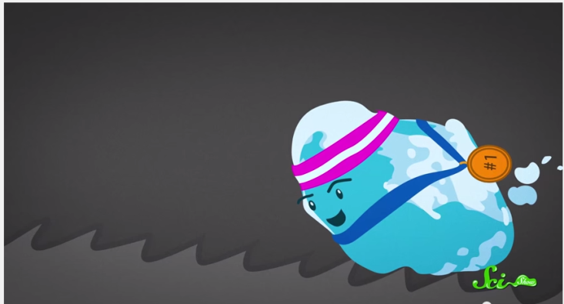
Introduction
The Leidenfrost Effect
Heating a liquid droplet above its boiling point creates a vapor pillow of its own gases underneath it
With little friction between vapor and surface, slight disturbances move the droplet
Ratchet surface gives just the right disturbance to control the movement
Notes:
Description of problem / user's work context -25%
Plan -10%
Process Model -5%
Team Organization -5%
Interface Design and System Design -25%
System to date/ What still is left -5%
Organization of presentation -10%
Creativity -15%

Slide 4
Our objective
Potential uses in micro-cooling
Customers, Dr. Ok and Dr. Guo, require data on droplet kinetics
Collect data from images taken through high-speed camera

Slide 5
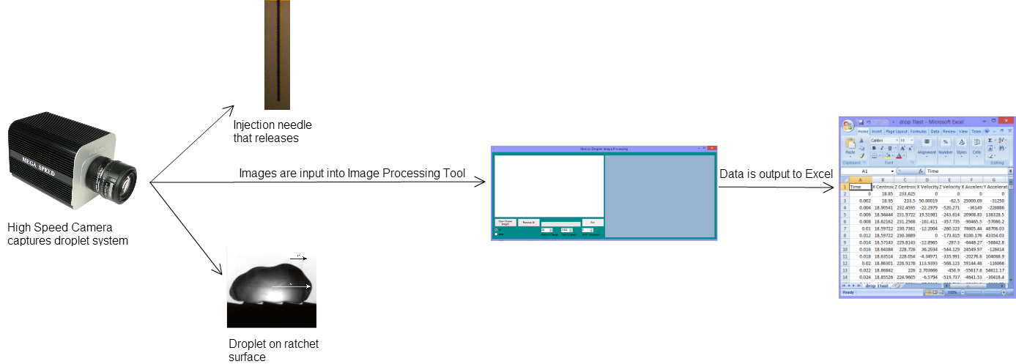
System Architecture

Slide 6
Demonstration

Slide 7
Test Report

Slide 8
Deployment Issues

Slide 9
Project Deviations

Slide 10
Hypothetical – Sanan
What if we had more time?
What if we could start over?
What we learned

Slide 11
Hypothetical – Anne
What if we had more time?
What if we could start over?
What we learned

Slide 12
Hypothetical – Romando
What if we had more time?
What if we could start over?
What we learned

Slide 13
Hypothetical – James
What if we had more time?
What if we could start over?
What we learned

Slide 14
Conclusion

Slide 15
References
"The Leidenfrost Effect: How to Make a Liquid Levitate." YouTube. YouTube, n.d. Web. 10 Mar. 2015.
Questions?

